Slide 1
Introduction to Data Science
Daniel Gutierrez, Data Scientist
Los Angeles, Calif.
Notes:
Welcome to the Introduction to Data Science course offered by UCLA Extension.

Slide 2
Course Outcomes
Deploy unsupervised machine learning methods for knowledge discovery
Notes:
This is WEEK 10 of the Introduction to Data Science course offered by UCLA Extension. This module covers unsupervised machine learning materials.

Slide 3
Lesson Objectives
Overview of unsupervised learning methods
Manually step through process yielding distinct clusters showing groupings and similarities in the data
Review the hierarchical clustering algorithm using R’s hclust() function to compute clusters and use data viz to display
Review the K-means clustering algorithm using R’s kmeans() function to compute clusters and use data viz to display
Notes:
The lesson objective for WEEK 10 is to look at unsupervised learning. Although not nearly as common as supervised learning, this methodology provides great potential for discovering previously unknown insights from existing unlabeled data sets. This means the data sets used for unsupervised learning do not contain a response variable, since we’re not trying to predict anything. The main use of unsupervised learning is to discover unknown patterns within data, e.g., grouping similar data or detecting outliers. Identifying clusters is a classical scenario of unsupervised learning.
Unsupervised refers to the fact that we’re trying to understand the structure of our underlying data, rather than trying to optimize for a specific, pre-labeled criterion (such as creating a predictive model). Unsupervised learning is a great technique for exploratory analysis, but it tends to be more subjective, since there is no specific goal like the prediction of a response variable. It is also difficult to assess the result obtained from unsupervised learning methods because there are no universally accepted procedures for evaluating model performance or validating results on an independent data set.
Lastly, we’ll take a look at two clustering methods: hierarchical clustering with the hclust() algorithm and K-means clustering with the kmeans() algorithm.

Slide 4
Unsupervised Learning Case Studies
To fully appreciate the ways unsupervised learning methods can help in a business setting, case studies are useful
Let’s present a series of 10 case studies using the k-means algorithm along with a variety of platforms including R, Python,
Each case study includes a link to a detailed technical article for further study

Slide 5
Unsupervised Machine Learning
#1 Document Classification - Cluster documents in multiple categories based on tags, topics, and the content of the document. This is a very standard classification problem and k-means is a highly suitable algorithm for this purpose. The initial processing of the documents is needed to represent each document as a vector and uses “term frequency” to identify commonly used terms that help classify the document. The document vectors are then clustered to help identify similarity in document groups. Here is a sample implementation in Java of the k-means for document clustering.

Slide 6
Unsupervised Machine Learning
#2 Delivery Store Optimization - Optimize the process of good delivery using truck drones by using a combination of k-means to find the optimal number of launch locations and a genetic algorithm to solve the truck route as a traveling salesman problem. Here is a theoretical (no code) whitepaper on the topic.

Slide 7
Unsupervised Machine Learning
#3 Identifying Crime Localities - With data related to crimes available in specific localities in a city, the category of crime, the area of the crime, and the association between the two can give quality insight into crime-prone areas within a city or a locality. Here is an interesting paper for using clustering based on crime data. You can use the outline from the paper to implement a solution in R.

Slide 8
Unsupervised Machine Learning
#4 Customer Segmentation - Clustering helps marketers improve their customer base, work on target areas, and segment customers based on purchase history, interests, or activity monitoring. Here is a theoretical research paper on how telecom providers can cluster pre-paid customers to identify patterns in terms of money spent in recharging, sending SMS, and browsing the internet. The classification would help the company target specific clusters of customers for specific campaigns.

Slide 9
Unsupervised Machine Learning
#5 Fantasy League Stat Analysis - Analyzing player stats has always been a critical element of the sporting world, and with increasing competition, machine learning has a critical role to play here. As an interesting exercise, if you would like to create a fantasy draft team and like to identify similar players based on player stats, k-means can be a useful option. Check out this article for details.

Slide 10
Unsupervised Machine Learning
#6 Insurance Fraud Detection - Machine learning has a critical role to play in fraud detection. Utilizing past historical data on fraudulent claims, it is possible to isolate new claims based on its proximity to clusters that indicate fraudulent patterns. Since insurance fraud can potentially have a multi-million dollar impact on a company, the ability to detect frauds is crucial. Here is a research paper using Weka Explorer on using clustering in automobile insurance to detect frauds.

Slide 11
Unsupervised Machine Learning
#7 Rideshare Data Analysis - The publicly available Uber ride information data set provides a large amount of valuable data around traffic, transit time, peak pickup localities, and more. Analyzing this data is useful not just in the context of Uber but also in providing insight into urban traffic patterns and helping us plan for the cities of the future. Here is a blog article using Spark ML K-means with links to a sample data set and a process for analyzing Uber data.

Slide 12
Unsupervised Machine Learning
#8 Cyber-Profiling Criminals - Cyber-profiling is the process of collecting data from individuals and groups to identify significant co-relations. The idea of cyber profiling is derived from criminal profiles, which provide information on the investigation division to classify the types of criminals who were at the crime scene. Here is an interesting research paper on how to cyber-profile users in an academic environment based on user data preferences.

Slide 13
Unsupervised Machine Learning
#9 Call Record Detail Analysis - A call detail record (CDR) is the information captured by telecom companies during a call, SMS, or internet activity of a customer. This information provides greater insights about the customer’s needs when used with customer demographics. In this blog article using R, you’ll see how you can cluster customer activities for 24 hours by using the unsupervised k-means clustering algorithm. It is used to understand segments of customers with respect to their usage by hours.

Slide 14
Unsupervised Machine Learning
#10 Automatic Clustering of IT Alerts - Large enterprise IT infrastructure technology components such as network, storage, or database generate large volumes of alert messages. Because alert messages potentially point to operational issues, they must be manually screened for prioritization for downstream processes. This blog article describing clustering of data, provides insight into categories of alerts and mean time to repair, and help in failure predictions.

Slide 15
Unsupervised Machine Learning
Can we find things that are close together?
How do we define close?
How do we group things?
How do we visualize the grouping?
How do we interpret the grouping?
Notes:
The primary method of unsupervised learning is called clustering, a very broad set of techniques used for identifying groups, or clusters, of values in a data set. Clustering organizes things that are ‘close’ and places them into groups. There are a number of things to consider when using clustering:
How do we define “close” when we talk about data measurements?
How do we group things once we’ve defined close?
How do we visualize the grouping?
How do we interpret the groupings created from this statistical process that might be hard to believe or were just created due to noise?

Slide 16
Unsupervised Machine Learning
How do we define close?
Most important step is selecting appropriate distance measure - garbage in -> garbage out
Distance or similarity
Continuous – Euclidean distance
Continuous – correlation similarity
Binary – Manhattan distance
Pick a distance or similarity that makes sense for your problem
Notes:
How we define closeness is the most important step in a clustering algorithm. The distance metric must be appropriate to the kind of data you have. If not, then you can expect to get clusters that are less easy to interpret, i.e., the patterns are less clearly represented. Some examples of distance or similarity measurements are: for continuous variables, you can use Euclidean distance, or instead of looking at the smallest distance, you can look at the greatest similarity, or binary measures of distance, such as the Manhattan distance. The choice of distance or similarity measure is very important to the problem you’re analyzing in order to get good clustering results.

Slide 17
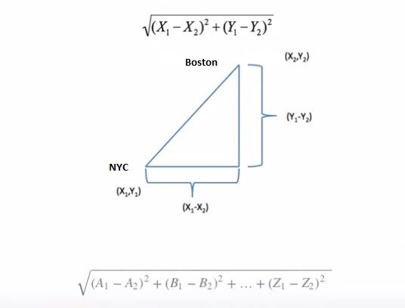
Unsupervised Machine Learning
Euclidean Distance
Notes:
Let’s consider Euclidean distance. It will be useful to visualize this metric with the figure showing how to look at the distance between New York City and Boston. As labeled on the graph, the y-coordinates measure the latitude values for both cities, and the x-coordinates measure longitude.
Further, y1-y2 is the difference between latitudes, and x1-x2 is the difference between the longitudes. What we’re looking to define is some combination of these two differences to measure the distance between NYC and Boston. If you recall from basic geometry, this is just the Pythagorean Theorem with the formula shown. Of course this distance measure is for 2-dimensions.
We can generalize the formula for many dimensions representing feature variables contributing to the clustering problem. We’ll arbitrarily use the letters A – Z to represent these variables in the generalized formula shown in the figure. This distance measure is used with quantitative (continuous) variables when performing clustering.

Slide 18
Unsupervised Machine Learning
Hierarchical clustering
Compute the distance between every pair of points/clusters:
Computing the distance between point A and point B is via the distance function
Computing the distance between point A and cluster B may first compute distance of all point pairs (one from cluster A and the other from cluster B) and then pick either min/max/avg of these pairs
Combine the two closest point/pairs into a cluster. Repeat step 1 until only one big cluster remains
Notes:
The hierarchical clustering algorithm compares all pairs of data points and then merges the pairs with the closest distance. The hclust() function in the stats package implements hierarchical clustering in R. To perform hierarchical clustering, we require a defined distance measure and a method for merging two observations. We’ll use Euclidean distance as the dissimilarity measure.
[SLIDE]
Hierarchical clustering is an agglomerative (bottom-up) approach toward the clustering process. You find the closest two observations or variables, merge them together into a single super observation, and then, using the rest of the observations plus the two you merged together, find the next closest two observations. This process continues until you’ve merged all the observations together into one big object. Since its complexity is high, hierarchical clustering is typically used when the number of points is not too great.
The visualization for hierarchical clustering is a tree structure type of plot called a dendrogram.

Slide 19
Unsupervised Machine Learning
K-means clustering
A partioning approach
Fix a number of clusters
Get “centroids” of each cluster
Assign things to closest centroid
Recalculate centroids
Requires
A defined distance metric
A number of clusters
An initial guess as to cluster centroids
Produces
Final estimate of cluster centroids
An assignment of each point to clusters
Notes:
K-means clustering is different from hierarchical clustering in that it is a partitioning approach as opposed to an agglomerative approach. A partitioning approach starts with all of the data points and tries to divide them into a fixed number of clusters. K-means is applied to a set of quantitative variables. The number of clusters is fixed in advance and then we must guess where the centers (called “centroids”) of those clusters might be. Next we assign points to the closest centroid and then recalculate the centroids to iterate through this clustering approach.
The requirements for K-means are:
READ: REQUIRES
The K-means algorithm produces:
READ: PRODUCES

Slide 20
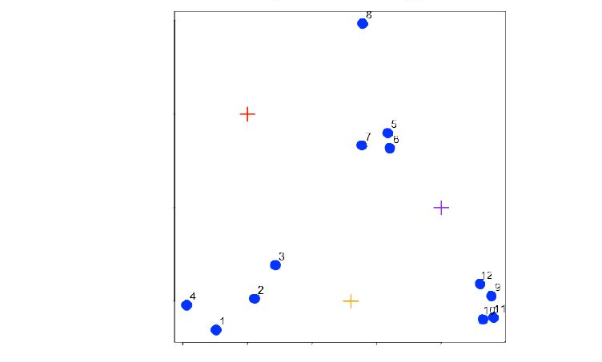
Unsupervised Machine Learning
K-means clustering – starting centroids
Notes:
Let’t take a look at a simple example of the K-means process.
With K-means, the number of clusters is fixed in advance and then we must guess where the centers (called “centroids”) of those clusters might be. Here, the initial centroids are marked with a plus sign. This is our starting point for the K-means algorithm.

Slide 21
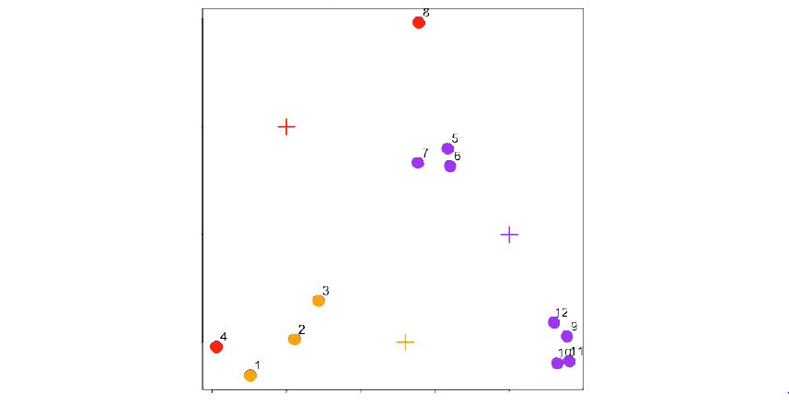
Unsupervised Machine Learning
K-means clustering – assign to closest centroid
Notes:
Next, we assign data points to the closest centroid using our distance metric, in this case Euclidean distance, to make that determination for each point. We assign different colors to the forming clusters.

Slide 22
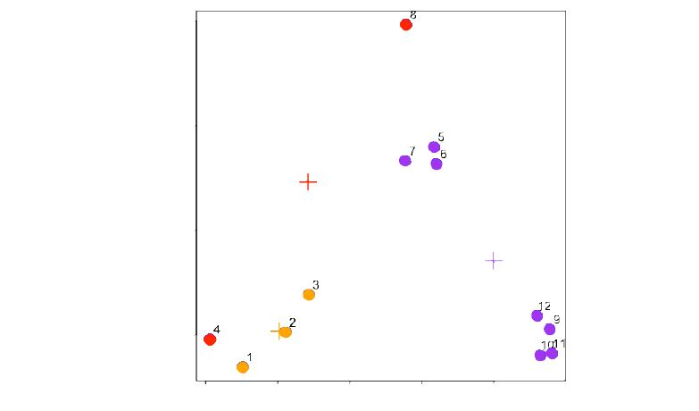
Unsupervised Machine Learning
K-means clustering – recalculate centroids
Notes:
Next, we recalculate the centroids.
To do this, we take the average x-value and average y-value of the points (4, 8) and get a new center for cluster 1. Likewise, we take the x and y average values for points, (1, 2, 3) and get a new centroid 2. Finally, we perform that same recalculation for centroid 3.

Slide 23
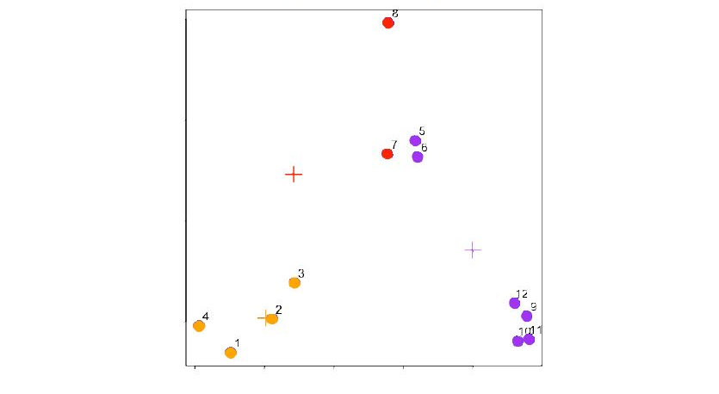

Unsupervised Machine Learning
K-means clustering – reassign values
Notes:
Then we can recalculate the distance to each centroid from each of the points and re-assign points to the appropriate centroids.

Slide 24
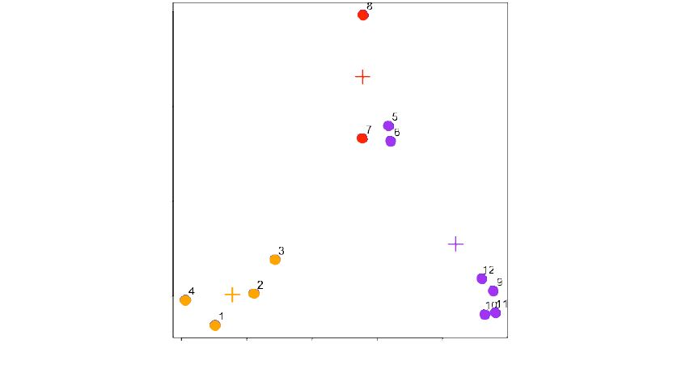
Unsupervised Machine Learning
K-means clustering – update centroids
Notes:
You continue to iterate this procedure by updating the centroids again. You’ll notice that the centroids move to align themselves with specific clusters.

Slide 25
Code modules
WEEK 10-1 Code module – EDA on simulated data set
WEEK 10-2 Code module – hierarchical clustering
WEEK 10-3 Code module – data viz for hierarchical clusters
WEEK 10-4 Code module – K-means clustering
WEEK 10-5 Code module – data viz for K-means clusters
WEEK 10-6 Code module – extensive example using K-means
Notes:
In order to demonstrate the concepts for WEEK 10, we’ll step through a series of in-depth R code examples found in the screencasts listed.
I encourage you to take the R script file for WEEK 10 and try each code snippet yourself. Take some time to tweak each example and try different things so you’ll fully understand each programming concept.

Slide 26
Summary
In WEEK 10 of Introduction to Data Science, we continued the data science process by exploring two popular unsupervised machine learning algorithms.
We used the hclust() algorithm for hierarchical clustering.
We used the kmeans() algorithm for K-means clustering.
Notes:
In WEEK 10 of Introduction to Data Science we continued the data science process by exploring two popular unsupervised machine learning algorithms.
We used R’s hclust() algorithm for hierarchical clustering (an agglomerative or bottom-up approach).
We also used R’s kmeans() algorithm for K-mean clustering (a partitioning approach).

